Slide 1

Project Presentation-I (IT System Log Analyzer) Group Id: PCS 26 - 29
Guided By:
Project Members
Name | Roll. No. | Section
Mridul Sharma | 2300290129007 | B
Mayank Kumar | 2300290129006 | B
Vikas Yadav | 2300290129015 | B
Name of Supervisor | Designation
Dr. Sunil Kumar | Associate Professor

Slide 2
Project Abstract
In Today world the growing infrastructure, This project propose the designing and development of an it system log analyser developed in python. A mechanism that was established to gather the data and information automatically based on system logs created by it infrastructures. In this project we identify the cybersecurity fuelled approaches and also identify the USER , LOG IN, changes coming into system andgive them into dashboard overview In the current digital world, the log of the system are becoming a primary source of information used to monitor performance, detect and prevent cyber attacks; however, the logs generated are stored. This project illustrates the need to combine Java flexibility and cybersecurity approaches to construct adaptive andsmart log analytics tool of contemporary IT landscape.

Slide 3
Project Goals and Objectives
Troubleshooting and Diagnostics: Identify and diagnose issues, errors, or anomalies in IT systems and applications.
Analysing logs helps pinpoint the root cause of problems and resolve them efficiently.
Performance Monitoring: Assess the performance of systems and applications by analyzing log data. Security and Compliance Monitor and detect potential security threats or breaches. operational behaviour of IT systems.

Slide 4

Alignment with UN Sustainable Development Goals (SDGs) https://sdgs.un.org/goals
SDG 7: Affordable and Clean Energy
Purpose The purpose is to provide organizations with a powerful tool to monitor, analyze, and optimize system logs in real time.
Alignment : Promoting energy efficiency in IT systems. Optimized log monitoring reduces wasted computational resources, lowers server energy consumption, and supports the integration of greener, cloud-based infrastructures. By improving system performance and enabling predictive maintenance, the tool indirectly contributes to increasing the share of clean and efficient energy use in the global IT ecosystem.

Slide 5
Technology Stack
Cybersecurity is the practice of protecting systems, networks, and programs from digital attacks. These cyberattacks are usually aimed at accessing, changing, or destroying sensitive information; extorting money from users through ransomware; or interrupting normal business processes.
Implementing effective cybersecurity measures is particularly challenging today because there are more devices than people, and attackers are becoming more innovative.
Blockchain is a shared, immutable ledger that facilitates recording transactions and tracking assets within a business network. Business runs on information. The faster the information is received and the more accurate it is, the better.

Slide 6
Literature Survey
S. NO. | Name | Title | Description / Proposed
1 | Xu, Wei, Ling Huang, Armando Fox, David Patterson, and Michael Jordan | Detecting large-scale system problems by mining console logs | Proposed mine this rich source of information to automatically detect system runtime problems
2 | He, Pingping, Jieming Zhu, Zibin Zheng, and Michael R. Lyu | System log analysis for anomaly detection | Proposed a system log analysis for anomaly detection has evolved significantly with the advent of deep learning techniques
3 | Yuan, Ding, et al | An analysis of production failures in distributed data-intensive systems. | A comprehensive study of large no. of user-reported failures across systems indicates that most failures can be emphasizing the potential for targeted testing.

Slide 7
Literature Survey
S.no. | Name | Title | Description
4 | Lou, Jian-Guang, Qiang Fu, Shengqi Yang | Mining Invariants from Console Logs for System Problem Detection. | Mining invariants from console logs is a critical approach for detecting system problems in large-scale distributed environments.
5 | Fu, Qiang, James Lou | Execution Anomaly Detection in Distributed Systems through Unstructured Log Analysis. | Execution anomaly detection through unstructured log analysis is a critical area of research due to the complexity and scaling of modern IT infrastructures.
6 | Chuvakin, Anton, Kevin Schmidt | The Authoritative Guide to Understanding the Concepts Surrounding Logging and Log Management | Logging serves for transparency and accountability in system operations.

Slide 8
7 | Zhang, Jieming, et al | Robust Log-based Anomaly Detection on Unstable Log Data | Robust log-based anomaly detection on unstable log data is a critical area of research.
8 | Splunk Inc | The Essential Guide to Machine Data | The platform excels in managing large volumes of machine-generated data, enabling organizations to derive actionable insights from their operational data.
9 | He, Pingping, Jieming Zhu, | Loghub: A Large Collection of System Log Datasets for AI-driven Log Analytics | It serves as a foundational element in various domains, from classical aesthetics to contemporary applications in cultural practices.
10 | Li, Zhenpeng, | Log Parsong :Challenges and Solutions | It serves as a foundational element from classical aesthetics to contemporary applications in cultural practices.
Literature Survey

Slide 9
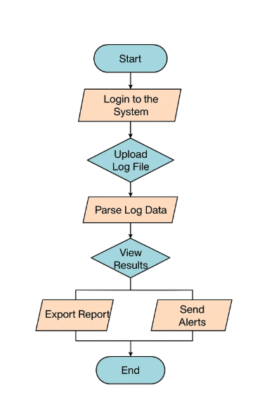
Methodology and Approach
The methodology for analyzing IT system logs typically involves a series of structured steps to effectively process, analyze, and interpret log data.
Data Collection involves gathering log data from various sources. Logs can come from servers, applications, network devices, databases, and security appliances.
Normalization is the process of cleaning logs so that they adhere to the same formats.
For Pattern recognition is the process of identifying patterns in logs, so that individual log entries can be handled appropriately.Like with any type of data analysis, your success with log analysis ultimately comes down to the techniques you use to interpret data.
Fig 1. Flowchart of Log analyzer

Slide 10
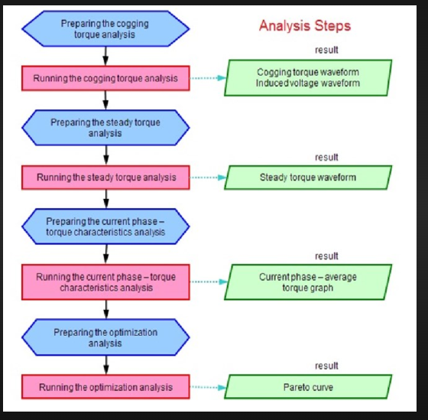
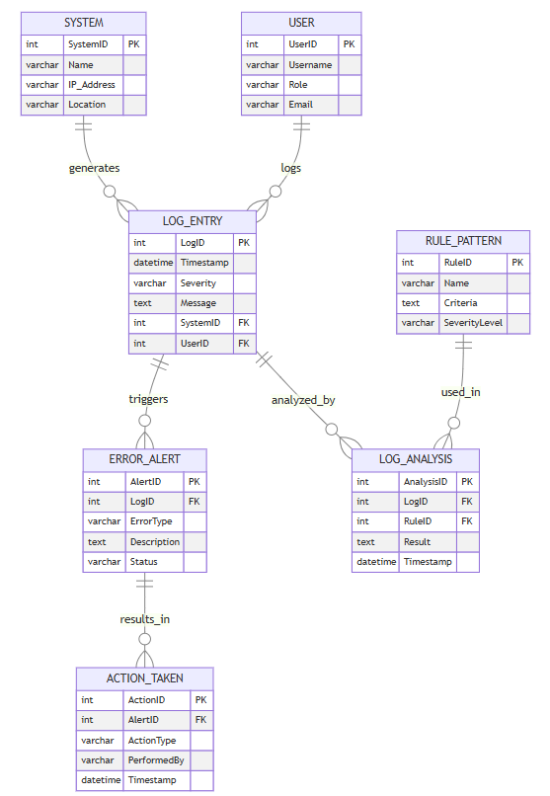
Workflow Diagram
Fig. 3 - Steps of working of LOG ANALYZER
Fig. 2 - ER Diagram of LOG ANALYZER

Slide 11

Patent/Research Paper (if any)
Paper Submitted to the conference on “Emerging VLSI and Semiconductor Technology for AI and Computing Application(EVST 2026)” which is organised by “KIET Deemed to be University.”
Paper ID – 1268
Status - Communicated

Slide 12
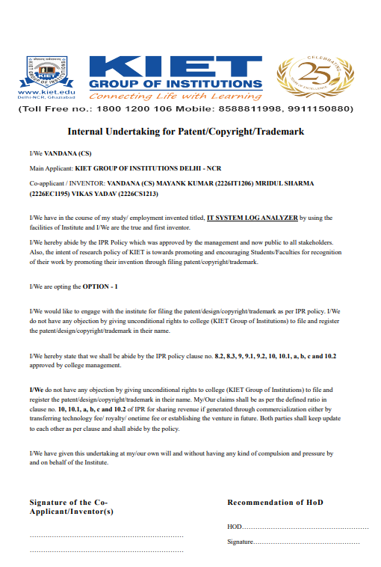
Patent/Research Paper (if any)
Title of Patent : BLOCKCHAIN-POWERED IT SYSTEM LOG ANALYZER FOR ENHANCED SECURITY
Filed in April 2025
Published upto September 2025

Slide 13
Project Status (if any module developed..)
Module Completion Status
User Interface (UI) Module
Log File Upload Module
Filtering Module (by Severity)
Log Parsing & Display Module
Export Logs Module
Advanced Features (Future Work)
Project Status
GUI Development: Completed
"Open Log File" button implemented.
Dropdown filter for severity levels
Table structure for displaying logs with columns Timestamp, Severity, Message.
"Export Logs" button is available.

Slide 14
Next Steps and Conclusion
The IT System Log Analyser serves as a critical tool for maintaining and improving the security, performance, and reliability of IT systems.
By effectively processing and analysing logs, the analyser provides several key benefits and results.
Improved detection and response to security threats.
The analyser aggregates and correlates log data from various sources to identify patterns and anomalies indicative of potential security breaches.
By analysing logs from firewalls, servers, and applications, the system can detect suspicious activities, unauthorised access attempts, and malware infections as security incidents. .

Slide 15
References (IN IEEE FORMAT)
Here are references in IEEE format for sources related to IT system log analyzers:
Xu, Wei, Ling Huang, Armando Fox, David Patterson, and Michael Jordan. "Detecting large-scale system problems by mining console logs." Proceedings of the ACM SIGOPS 22nd Symposium on Operating Systems Principles (SOSP), 2009. https://doi.org/10.1145/1629575.1629602
He, Pingping, Jieming Zhu, Zibin Zheng, and Michael R. Lyu. "Experience report: System log analysis for anomaly detection." 27th IEEE International Symposium on Software Reliability Engineering (ISSRE), 2016. https://doi.org/10.1109/ISSRE.2016.58
Yuan, Ding, et al. "Simple testing can prevent most critical failures: An analysis of production failures in distributed data-intensive systems." USENIX Symposium on Operating Systems Design and Implementation (OSDI), 2014. https://www.usenix.org/conference/osdi14/technical-sessions/presentation/yuan
Lou, Jian-Guang, Qiang Fu, Shengqi Yang, Ye Xu, and Jiang Li. "Mining Invariants from Console Logs for System Problem Detection." USENIX Annual Technical Conference, 2010. https://www.usenix.org/legacy/event/atc10/tech/full_papers/Lou.pdf

Slide 16
Fu, Qiang, James Lou, Yi Wang, and Jiang Li. "Execution Anomaly Detection in Distributed Systems through Unstructured Log Analysis." IEEE International Conference on Data Mining (ICDM), 2009. https://doi.org/10.1109/ICDM.2009.90
Chuvakin, Anton, Kevin Schmidt, and Chris Phillips. "Logging and Log Management: The Authoritative Guide to Understanding the Concepts Surrounding Logging and Log Management." Syngress Publishing, 2012. ISBN: 978-1597496353.
Zhang, Jieming, et al. "Robust Log-based Anomaly Detection on Unstable Log Data." Proceedings of the 2019 ACM Joint Meeting on European Software Engineering Conference and Symposium on the Foundations of Software Engineering (ESEC/FSE), 2019. https://doi.org/10.1145/3338906.3338942
Splunk Inc. "The Essential Guide to Machine Data." Splunk White Paper, 2014. https://www.splunk.com/pdfs/ebooks/the-essential-guide-to-machine-data.pdf
9. He, Pingping, Jieming Zhu, Zibin Zheng, and Michael R. Lyu. "Loghub: A Large Collection of System Log Datasets for AI-driven Log Analytics." 2019 IEEE International Symposium on Software Reliability Engineering Workshops (ISSREW), 2019. https://doi.org/10.1109/ISSREW.2019.00067

Slide 17
10. Li, Zhenpeng, Min Zheng, and Ding Yuan. "Log Parsing: Challenges and Solutions." ACM Queue, 2021. https://queue.acm.org/detail.cfm?id=3471316

Slide 18



